Slide 1


AD-HOC-REQUEST

Slide 2
AGENDA
COMPANY OVERVIEW
ABOUT DATA
OBJECTIVE
ANALYSIS
INSIGHTS

Slide 3
COMPANY
Atliq Hardwares is one of the leading computer hardware producers in India and well expanded
Atliq hardware is a dynamic and continuously growing group of companies creating a buoyant economic climate. The group is focused on generating economic prosperity for the Stakeholders while growing harmoniously with the community and environment.
Leveraging business from an expanding product portfolio, Trident Limited, the flagship company of the group, is one among the top 5 global terry towel giants.

Slide 4
ABOUT DATA
It is sales data of Atlqi Hardware which holding information of 2020-2021.
It contain 5 tables.
Dim_product
Dim_customer
Dim_fact_gross_price
Dim_fact_sales_price
dim_pre_invoice_discount
Dim_monthly_sales

Slide 5
Objective
Squeezing data to give more and more information.
To take decisions on basis of Analysis.

Slide 6
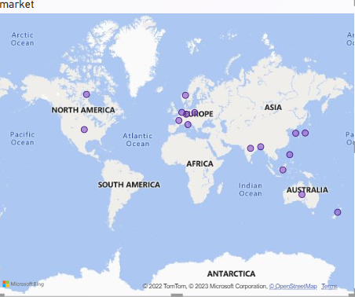
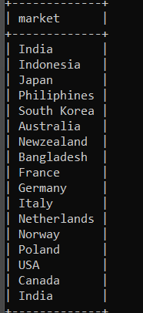
QUESTION 1:
Provide the list of markets in which customer "Atliq Exclusive" operates its business in the APAC region
Code:
select market from dim_customer where customer="Atliq Exclusive";

Slide 7
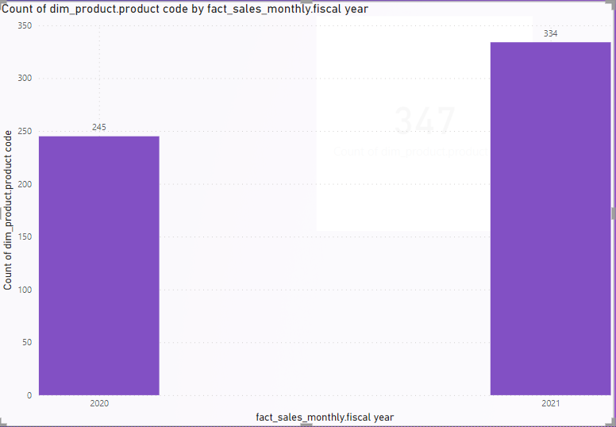
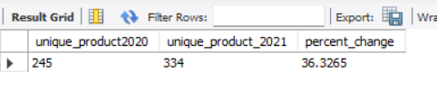
QUESTION 2: What is the percentage of unique product increase in 2021 vs. 2020? The final output contains these fields, unique_products_2020 unique_products_2021 Percentage_chg
CODE:
select a.twenty as"unique_product2020" ,b.twentyone as "unique_product_2021",((b.twentyone-a.twenty)/((a.twenty/100))) as "percent_change" from (select count(distinct(dp.product_code))as"twenty" from dim_product dp join fact_sales_monthly fm on dp.product_code = fm.product_code where fm.fiscal_year="2020")ajoin(select count(distinct(dp.product_code))as "twentyone" from dim_product dp join fact_sales_monthly fm on dp.product_code = fm.product_code where fm.fiscal_year="2021")b;

Slide 8
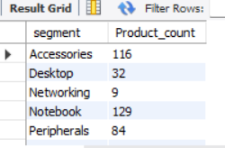
QUESTION 3: Provide a report with all the unique product counts for each segment and sort them in descending order of product counts. The final output contains 2 fields,
segment
Product_count
CODE: select segment, count(distinct(product_code)) as "Product_count" from dim_product group by(segment) order by product_count DESC;

Slide 9
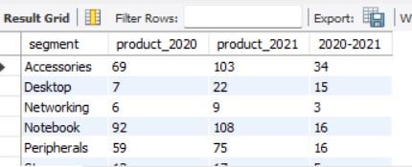
QUESTION 4:
Follow-up: Which segment had the most increase in unique products in 2021 vs 2020? The final output contains these fields, segment product_count_2020
Product_count_2021
difference
Code:
with productdiff as(select b.segment as "segment",COUNT(distinct(case when fiscal_year = 2020 then a.product_code end)) asproduct_count_2020,COUNT(distinct(case when fiscal_year = 2021 then a.product_code end)) as product_count_2021 from fact_sales_monthly as a inner join dim_product as bON a.product_code = b.product_codegroup by b.segment)select segment as "segment", product_count_2021, product_count_2021,(product_count_2021-product_count_2020) AS "2020-2021"from productdifforder by 2020-2021 desc;

Slide 10
QUESTION 5:
Get the products that have the highest and lowest manufacturing costs. The final output should contain these fields,
Product_code
product manufacturing_cost
CODE:
select min(manufacturing_cost) into @myvar from fact_manufacturing_cost;
select max(manufacturing_cost) into @myvarmax from fact_manufacturing_cost;
select p.product_code,p.product,mc.manufacturing_cost from dim_product p
join fact_manufacturing_cost mc on p.product_code=mc.product_code where mc.manufacturing_cost=@myvar
union
select p.product_code,p.product,mc.manufacturing_cost from dim_product p
join fact_manufacturing_cost mc on p.product_code=mc.product_code where mc.manufacturing_cost=@myvarmax;

Slide 11
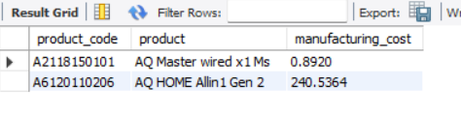
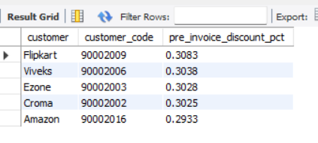
QUESTION 6: Generate a report which contains the top 5 customers who received an average high pre_invoice_discount_pct for the fiscal year 2021 and in the Indian market. The final output contains these fields,
customer_code
customer
CODE: select c.customer,c.customer_code,(f.pre_invoice_discount_pct) from dim_customer c
join fact_pre_invoice_deductions f on c.customer_code=f.customer_code where c.market="India" and f.fiscal_year="2021" and f.pre_invoice_discount_pct> @myvar order by(f.pre_invoice_discount_pct) desc limit 5;

Slide 12
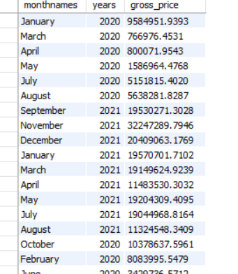
QUESTION 7:Get the complete report of the Gross sales amount for the customer “Atliq Exclusive” for each month . This analysis helps to get an idea of low and high-performing months and take strategic decisions. The final report contains these columns:
Month
Year
Gross sales Amount
CODE: select Monthname(fd.date) as "monthnames", fd.fiscal_year as "years", sum(fd.sold_quantity*fg.gross_price) as "gross_price"
from dim_customer c join fact_sales_monthly fd on c.customer_code=fd.customer_code
join fact_gross_price fg on fd.product_code =fg.product_code where c.customer = "Atliq Exclusive" group by monthnames,years;

Slide 13
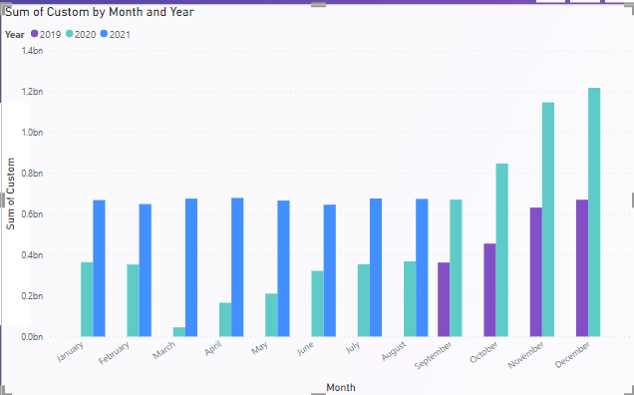

Slide 14
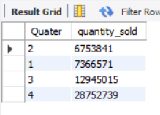
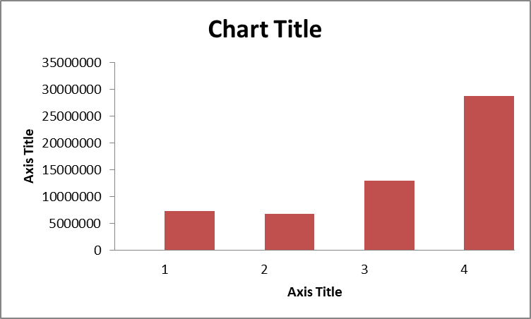
QUESTION 8:
In which quarter of 2020, got the maximum total_sold_quantity? The final output contains these fields sorted by the total_sold_quantity, Quarter
total_sold_quantity
CODE:select quarter(fd.date) as "Quater" ,sum(fd.sold_quantity) as "quantity_sold"
from dim_customer c join fact_sales_monthly fd on c.customer_code=fd.customer_code
join fact_gross_price fg on fd.product_code =fg.product_code where year(fd.date)=2021 group by(quarter(fd.date)) order by (quantity_sold) ;

Slide 15
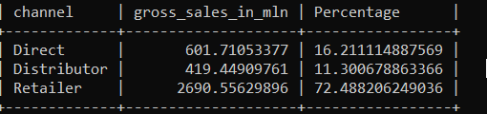
QUESTION 9:
Which channel helped to bring more gross sales in the fiscal year 2021 and the percentage of contribution? The final output contains these fields,
channel
Gross_sales_mln
Percentage
CODE:
select channel, sum(fd.sold_quantity*fg.gross_price)/1000000 as "gross_sales_in_mln",((sum(fd.sold_quantity*fg.gross_price)/1000000)*(100/3711.7159303301)) as "Percentage"
from dim_customer c join fact_sales_monthly fd on c.customer_code=fd.customer_code
join fact_gross_price fg on fd.product_code =fg.product_code group by(channel) ;

Slide 16
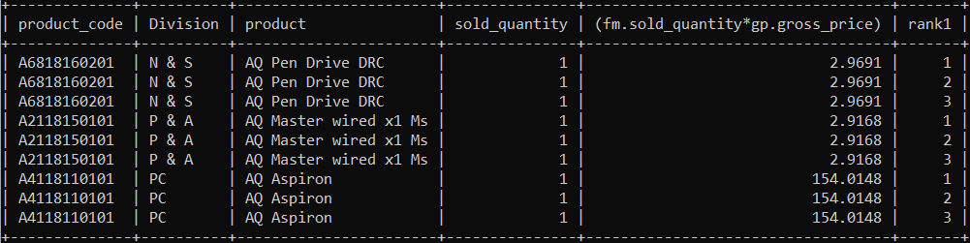
QUESTION 10: Get the Top 3 products in each division that have a high total_sold_quantity in the fiscal_year 2021? The final output contains these fields,
division
product_code
product
Total_sold_quantity
CODE: select * from
(select dp.product_code as "product_code",dp.division as "Division",dp.product,fm.sold_quantity as "sold_quantity",(fm.sold_quantity*gp.gross_price) ,row_number() over(partition by dp.division order by(fm.sold_quantity*gp.gross_price) ) as "rank1" from dim_product dp
join fact_sales_monthly fm on dp.product_code=fm.product_code
join fact_gross_price gp on dp.product_code=gp.product_code)ranks
where rank1<=3;

Slide 17
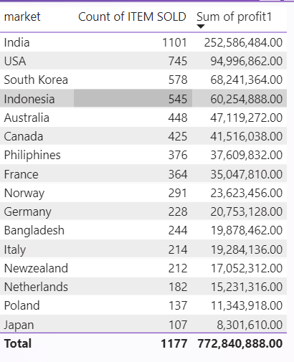
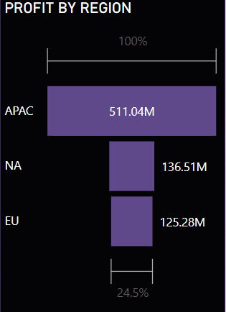
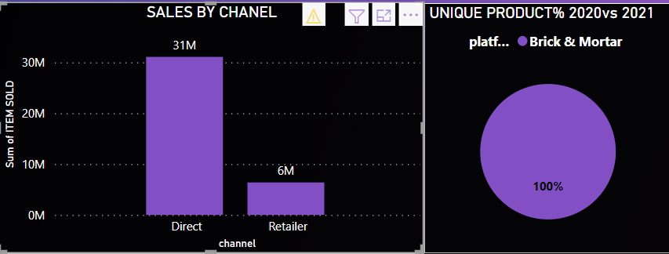
Atliq Exclusive operate in 16 countries.
It get most of its sales from APAC region.
Only operator in market of Atliq is Brick&Mortar.
It get sales only by chanels retail and direct.

Slide 18
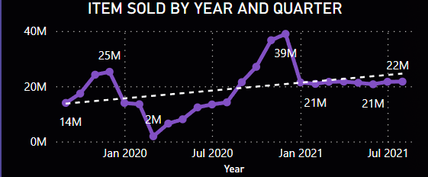
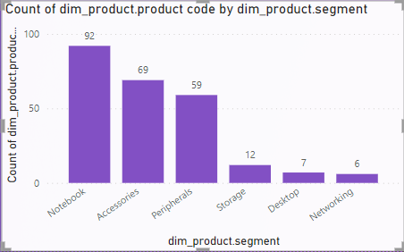
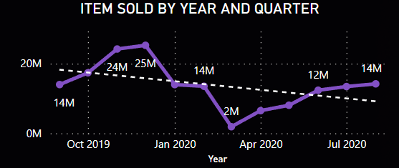
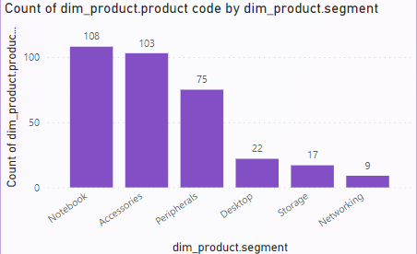
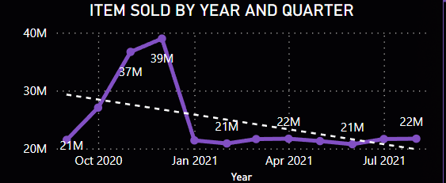
With year in 2020 to 2021 there is add on of 33% new product.
Over all sales from 2020 to 2021 was with positive trend.
Product in 2020
In 2020 sales was with negative trend
Product in 2021
In 2021 sales was with negative trend

Slide 19
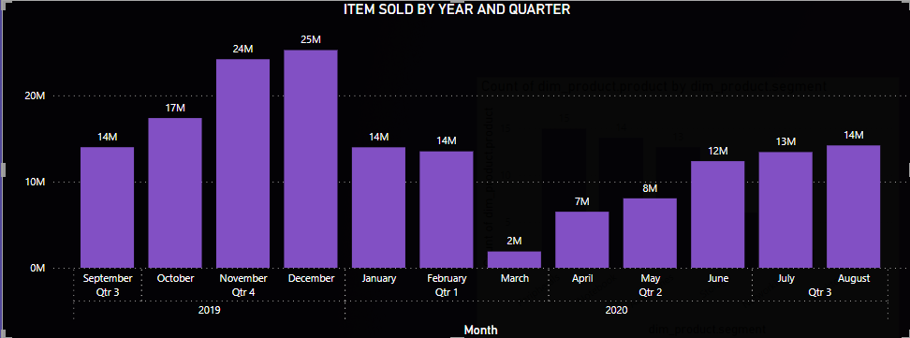
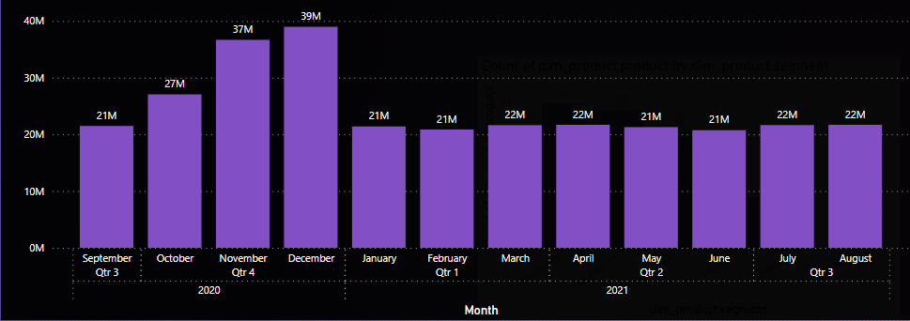
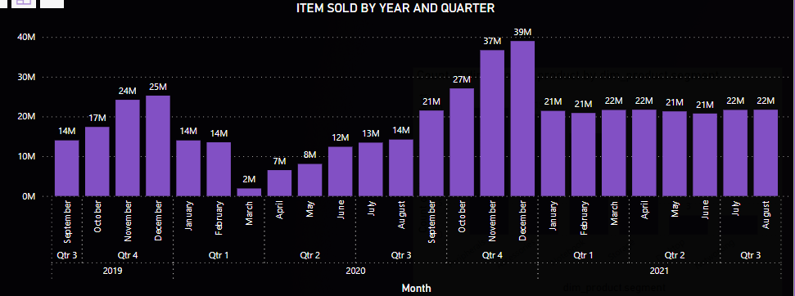
Quarter Analysis
Quarter of 2020
Quarter of 2021
Over All

Slide 20
FOR MORE ANALYSIS AND VISUL PLS VISIT THE BELOW LINK
CLICK HERE TO VIEW RECORD

